Slide 1
递归下降语法分析
编译技术实验(2)
周尔强

Slide 2
递归下降分析举例
exp: factor
| exp '+' factor
| exp '-' factor
;
factor: term
| factor '*' term
| factor '/' term
;
term: NUMBER
| '-' term
;
Zhou, Erqiang

Slide 3
递归下降分析举例
exp: factor
| exp '+' factor
| exp '-' factor
;
语言：factor +/- factor +/- factor ...
程序：
void exp(){
factor();
while( tok == '+' || tok == '-'){
advance();
factor();
}
}
+/- factor +/- factor ...
重复出现的部分
School of Information and Software Engineering
Zhou, Erqiang

Slide 4
递归下降分析举例
factor: term
| factor '*' term
| factor '/' term
;
语言：term */ term */ term ...
程序：
void factor(){
term();
while( tok == '*' || tok == '/'){
advance();
term();
}
}
*/ term */ term ...
重复出现的部分
School of Information and Software Engineering
Zhou, Erqiang

Slide 5
递归下降分析举例
语言：NUMBER、 - NUMBER
- - NUMBER、- - - NUMBER
程序：
void term(){
if( tok == NUMBER );
advance();
else if ( tok == '-'){
advance();
term();
}
else error();
}
term: NUMBER
| '-' term
;
School of Information and Software Engineering
Zhou, Erqiang

Slide 6
递归下降分析举例
纯粹的语法分析只分析
词法记号序列是否符合语言的文法
如 -5+20*5-3
实际的编译器
需要找出词法记号序列的结构
即语法树
School of Information and Software Engineering
Zhou, Erqiang

Slide 7
递归下降文法举例
exp: factor
| exp '+' factor
| exp '-' factor
;
factor: term
| factor '*' term
| factor '/' term
;
term: NUMBER
| '-' term
;
exp
exp
exp
factor
factor
factor
term
factor
term
term
term
term
-
5
+
20
*
5
-
3
School of Information and Software Engineering
Zhou, Erqiang

Slide 8
递归下降文法举例
抽象的语法树
（Abstract Syntax Tree, AST）
exp
exp
-
exp
+
3
factor
factor
factor
term
factor
-
*
term
term
term
term
null
5
20
5
-
5
+
20
*
5
-
3
School of Information and Software Engineering
Zhou, Erqiang

Slide 9
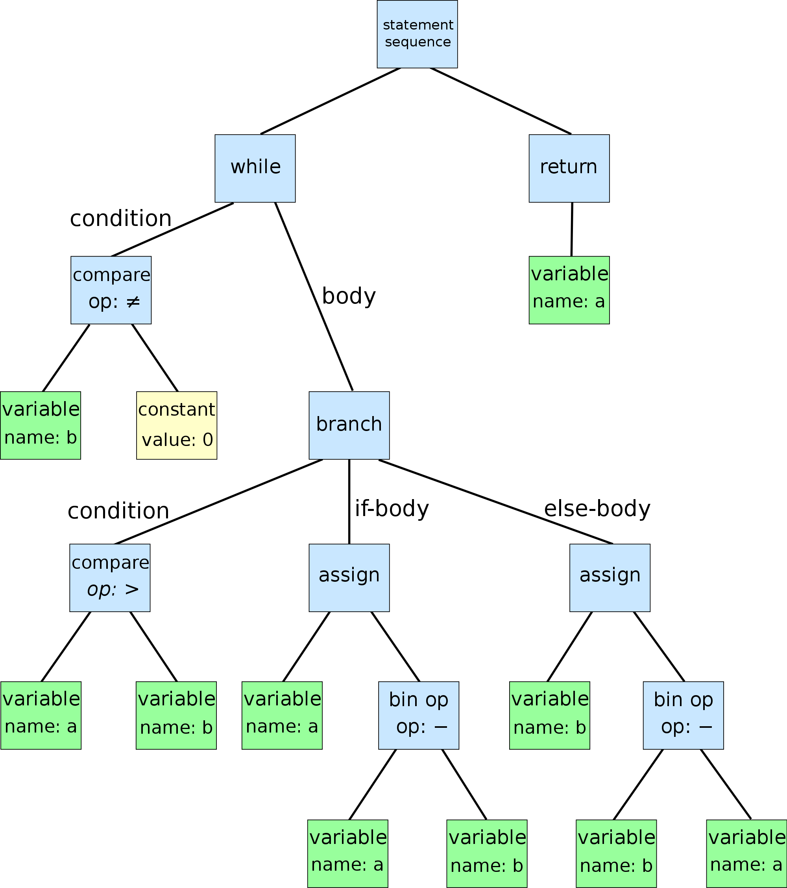
抽象语法树
while b ≠ 0
if a > b
a := a − b
else
b := b − a
return a
School of Information and Software Engineering
Zhou, Erqiang

Slide 10
表达式的抽象语法树
抽象语法树结点设计
所有树结点统一为 一个 结构类型
如何区别结点：赋值语句？选择语句？
结点内需要 用标志位
结点的最大分支数
表达式最多为二元运算，至少 2 个
结点为树的叶结点
需要保存运算的数值
School of Information and Software Engineering
Zhou, Erqiang

Slide 11
表达式的抽象语法树
抽象语法树结点设计
typedef struct _ast ast;
typedef struct _ast *past;
struct _ast{
int ivalue;
char* nodeType;
past left;
past right;
};
School of Information and Software Engineering
Zhou, Erqiang

Slide 12
表达式的抽象语法树
past astFactor()
{
past l = astTerm();
while(tok == '*' || tok == '/')
{
int oper = tok;
advance();
past r = astTerm();
l = newExpr(oper, l, r);
}
return l;
}
递归下降分析函数
void factor(){
term();
while( tok == '*' || tok == '/')
{
advance();
term();
}
}
School of Information and Software Engineering
Zhou, Erqiang

Slide 13
实验任务
1. 学习所提供的“表达式文法”的递归下降处理
理解 lex.l、rdparser.c的内容
在eclipse中建立工程并调试运行
2. 学习rdgram.txt所提供的文法
与词法分析所提供的文法作比较
School of Information and Software Engineering
Zhou, Erqiang

Slide 14
实验任务
3. 编写rdgram所提供文法的递归下降程序
(1)编写不生成“语法树”的递归下降程序 rdcheck.c
(2)将rdcheck.c改造为生成语法树的递归下降程序rdparser.c
(3)改进 词法分析程序、showAst函数、main函数等，使递归下降程序rdparser最终从命令行读取要分析的程序test.c,分析后调用showAst打印该程序的结构。
School of Information and Software Engineering
Zhou, Erqiang

Slide 15
实验安排要求
1. 实验分组与实验一相同，每组只需交一份代码，每位同学都需要交一份报告
2. 所有文件都以 utf-8 进行统一编码保存！！！
(检查环境为Linux，如出现乱码等错误，扣 1 分！)
School of Information and Software Engineering
Zhou, Erqiang

Slide 16
实验安排要求
3. 提交文件：
词法分析程序 c14_lex.l
不生成“语法树”的递归下降程序 rdcheck.c
生成语法树的递归下降程序 rdparser.c
实验报告 递归下降分析法.docx
未按此规定命名的提交 扣 1 分。
School of Information and Software Engineering
Zhou, Erqiang

Slide 17
实验安排要求
4. 提交方式
组长用自己QQ登录腾讯 微云 http://www.weiyun.com/
之后以组长“学号_姓氏_实验2”的格式建立文件夹
(如 2013110101011_周_实验2）
将所需的文件上传至该文件夹，之后分享该文件夹
切勿设置访问密码，否则视为未提交
将分享链接发到 531068099@qq.com
发到其它邮箱视为未提交
School of Information and Software Engineering
Zhou, Erqiang

Slide 18
实验安排要求
5. 提交截止日期
北京时间 2018年11月20日23:59:59（周六）
此时间之后 再发分享链接 或 更改文件夹内容 将无效
School of Information and Software Engineering
Zhou, Erqiang

Slide 19
THE END
QUESTIONS
School of Information and Software Engineering
Zhou, Erqiang

Slide 20
递归下降分析举例
program
: external_declaration
| program external_declaration
;
external_declaration
: type declarator decl_or_stmt
;
decl_or_stmt
: '{' statement_list '}'
| '{' '}'
| ',' declarator_list ';'
| ';'
;
declarator_list
: declarator
| declarator_list ',' declarator
;
intstr_list
: NUMBER | STRING
| intstr_list ',' NUMBER
| intstr_list ',' STRING
;
declarator
: ID
| ID '=' expr
| ID '(' parameter_list ')'
| ID '(' ')'
| ID '[' expr ']'
| ID '[' ']'
| ID '[' expr ']' '=' '{' intstr_list '}'
| ID '[' ']' '=' '{' intstr_list '}'
;
parameter_list
: parameter
| parameter_list ',' parameter
;
School of Information and Software Engineering
Zhou, Erqiang

Slide 21
递归下降分析举例
statement
: type declarator_list ';'
| '{' statement_list '}'
| expr_statement
| IF '(' expr ')' statement
| IF '(' expr ')' statement ELSE statement
| WHILE '(' expr ')' statement
| RETURN ';'
| RETURN expr ';'
| PRINT ';'
| PRINT expr_list ';'
| SCAN id_list ';'
;
statement_list
: statement
| statement_list statement
;
parameter
: type ID
;
type
: INT | STR | VOID
;
expr_statement
: ';'
| expr ';'
;
expr_list
: expr
| expr_list ',' expr
;
id_list
: ID
| id_list ',' ID
;
School of Information and Software Engineering
Zhou, Erqiang

Slide 22
递归下降分析举例
mul_expr
: primary_expr
| mul_expr '*' primary_expr
| mul_expr '/' primary_expr
| mul_expr '%' primary_expr
| '-' primary_expr
;
primary_expr
: ID '(' expr_list ')'
| ID '(' ')'
| '(' expr ')'
| ID
| NUMBER
| STRING
| ID ASSIGN expr
| ID '=' expr
| ID '[' expr ']'
| ID '[' expr ']' '=' expr
;
expr
: cmp_expr
;
cmp_expr
: add_expr
| cmp_expr CMP add_expr
;
add_expr
: mul_expr
| add_expr '+' mul_expr
| add_expr '-' mul_expr
;
School of Information and Software Engineering
Zhou, Erqiang

Slide 23
递归下降分析举例
程序在词法分析后的结果是？
enum {INT = 258, STR, VOID, ID, NUMBER, STRING, PRINT, RETURN, ...}
INT ID [ NUMBER ] = { NUMBER , NUMBER , NUMBER , NUMBER }
10 10 9 8 7
INT, ID, NUMBER 等为枚举类型定义的值
'[' ']' '{' ',' '=' 等为符号对应ASCII编码的值
STR ID ( INT ID ) { STR ID = STRING + STRING ; STR ID = STRING + ...
int array2[10] = {10,9,8,7};
str f(int a)
{
str b = "aaa" + "ddd";
str c = "ccc" + "bb";
print c;
return c;
}
School of Information and Software Engineering
Zhou, Erqiang

Slide 24
递归下降分析举例
int array2[10] = {10,9,8,7};
str f(int a)
{
str b = "aaa" + "ddd";
str c = "ccc" + "bb";
print c;
return c;
}
program ==>
external_declaration
==> type declarator decl_or_stmt
==> INT ID '[' expr ']' = '{' intstr_list '}'
;
decl_or_stmt
: '{' statement_list '}'
| '{' '}'
| ',' declarator_list ';'
| ';'
;
declarator
: ID
| ID '=' expr
| ID '(' parameter_list ')'
| ID '(' ')'
| ID '[' expr ']'
| ID '[' ']'
| ID '[' expr ']' '=' '{' intstr_list '}'
| ID '[' ']' '=' '{' intstr_list '}'
;
School of Information and Software Engineering
Zhou, Erqiang

Slide 25
递归下降分析举例
int array2[10] = {10,9,8,7};
str f(int a)
{
str b = "aaa" + "ddd";
str c = "ccc" + "bb";
print c;
return c;
}
program ==>
external_declaration
==> type declarator decl_or_stmt
==> INT ID [ expr ] = { intstr_list } ;
expr ==> cmp_expr ==> add_expr ==> mul_expr ==> primary_expr ==> NUMBER
intstr_list ==> intstr_list , NUMBER
intstr_list ==> intstr_list , NUMBER , NUMBER
intstr_list ==> intstr_list , NUMBER , NUMBER , NUMBER
intstr_list ==> NUMBER , NUMBER , NUMBER , NUMBER
==> INT ID [ NUMBER ] = { NUMBER , NUMBER , NUMBER , NUMBER }
token对应的属性 10 10 9 8 7
intstr_list
: NUMBER | STRING
| intstr_list ',' NUMBER
| intstr_list ',' STRING
;
School of Information and Software Engineering
Zhou, Erqiang

Slide 26
递归下降分析举例
external_declaration
: type declarator decl_or_stmt
;
past external_declaration()
{
past result = NULL;
past t = type();
past d = declarator();
past ds = decl_or_stmt();
result = newExtDecl(t, d, ds);
return result;
}
School of Information and Software Engineering
Zhou, Erqiang

Slide 27
递归下降分析举例
program
: external_declaration
| program external_declaration
;
递归程序？
parameter_list
: parameter
| parameter_list ',' parameter
;
past program()
{
advance();
past ext = external_declaration();
past list = newList(NULL, ext);
while( tok )
{
ext = external_declaration();
list = newList(list, ext);
}
return list;
}
past parameter_list()
{
past result = newList(NULL, parameter());
while(tok == ',')
{
advance();
result = newList(result, parameter());
}
return result;
}
School of Information and Software Engineering
Zhou, Erqiang

Slide 28
递归下降分析举例
int array2[10] = {10,9,8,7};
str f(int a)
{
str b = "aaa" + "ddd";
str c = "ccc" + "bb";
print c;
return c;
}
program ==>
program external_declaration
==> external_declaration external_declaration
==> ... type declarator decl_or_stmt
==> ... STR ID ( parameter_list ) { statement_list }
declarator
: ID
| ID '=' expr
| ID '(' parameter_list ')'
| ID '(' ')'
| ID '[' expr ']'
| ID '[' ']'
...
;
decl_or_stmt
: '{' statement_list '}'
| '{' '}'
| ',' declarator_list ';'
| ';'
;
School of Information and Software Engineering
Zhou, Erqiang

Slide 29
递归下降分析举例
statement
: type declarator_list ';'
| '{' statement_list '}'
| expr_statement
| IF '(' expr ')' statement
| IF '(' expr ')' statement ELSE statement
| WHILE '(' expr ')' statement
| RETURN ';'
| RETURN expr ';'
| PRINT ';'
| PRINT expr_list ';'
| SCAN id_list ';'
;
statement_list
: statement
| statement_list statement
;
newDecl(...)
newCompStmt(...)
newExprStmt(...)
newIfStmt(...)
newWhileStmt(...)
newReturnStmt(...)
newPrintStmt(...)
newScanStmt(...)
School of Information and Software Engineering
Zhou, Erqiang

